Slide 1
Lesson 1.3
How HTML, CSS, and JavaScript Work Together

Slide 2
Learning Outcomes
Build a conceptual understanding of HTML, CSS, and JavaScript

Slide 3


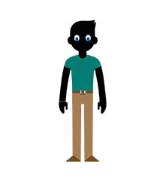
HTML, CSS, and JS Working Together
HTML CSS JavaScript
Notes:
HTML:
The body itself
Tells the browser what to display
Content and basic structure
Describes and defines
Made up of elements
CSS:
The body’s accessories
Tells the browser how to display
Adds color, effects, animation, spacing, and other styles
Provides additional structure
Determines display depending on viewport
JavaScript:
The body’s ability to perform actions
Tells the browser how to function
The behavior of the website
The ability to perform actions
Allows the user to interact with the website

Slide 4
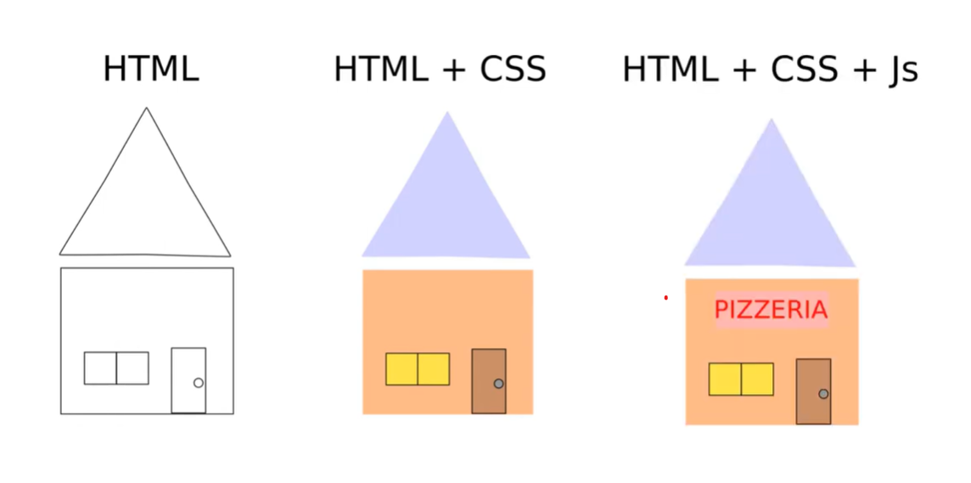
HTML, CSS, and JS Working Together
Notes:
HTML:
Like how walls, floors, and rooms define the structure of a house
HTML creates the framework and organizes the content of a webpage
CSS:
Interior design of a house: paint, wallpaper, furniture, lighting
CSS controls the presentation of HTML elements (fonts, spacing, colors)
JavaScript
Like the electrical and plumbing systems of a house
JS allows you to add dynamic features, respond to user actions, form validation, interactive maps, and animations
Any other real-life analogies?

Slide 5
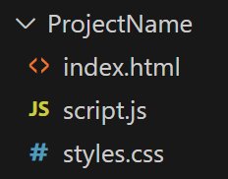
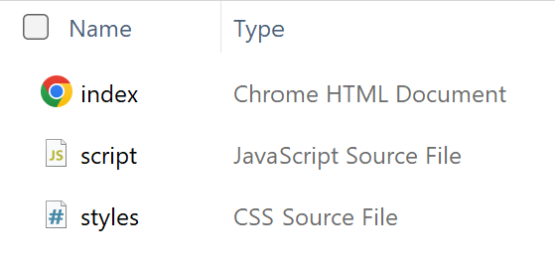
Proper File Structure
Simple project
One HTML page (the homepage)
One CSS file
One JavaScript file

Slide 6
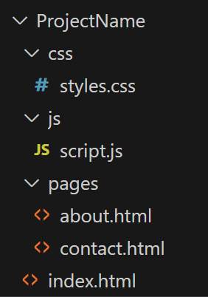
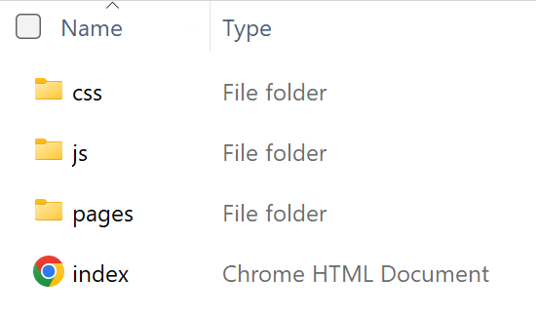
Proper File Structure
Complex project
One HTML homepage (index.html)
Multiple other HTML pages in a folder
Multiple CSS files in a folder
Multiple JavaScript files in a folder

Slide 7
Learning Activity 1.3.1
“Identify HTML, CSS, JS Components of a Website”
Can you find a website that uses only HTML?
Can you find a website that uses only HTML and CSS?
Can you find a website that uses HTML, CSS, and JavaScript?
Can you figure out what is the responsibility of HTML for the Google.com website? CSS is in charge of what? And what part does JavaScript play?
https://www.google.com/

Slide 8
Learning Activity: Inspect a website
Pick a website that you frequent
Right-click > “Inspect” or “View Page Source”
Find 3 HTML elements in the <body>
Find a CSS “stylesheet” in the <head>
<style></style>
<link rel="stylesheet“ href=“[...].css">
Find a JavaScript “script” in the <head>
<script></script>
Notes:
https://www.commonsensemedia.org/

Slide 9
For next class
Read Lesson 1.4
Do Learning Activities 1.4.1, 1.4.2
Come prepared to share your code
Assessments Reminder:
Engagement is worth 10% of your final grade. Engage by sharing code, asking or answering questions, etc.
All assessment dates have been posted in the D2L calendar.
See the “Assignments Policy” for late submission procedures.

Slide 10
References
https://www.youtube.com/watch?v=D4ViURktouQ&ab_channel=Acadea.io

